Slide 1

Algorithmic Trading by ML
Group 1
Khadijah , Duaa, Yasmeen, Abdullah, Lama, Bashayer

Slide 2
INTRODUCTION
analyzing data for some tasks like predicting stock market movements has become impractical hence the need for automation.
Trading with algorithms has the advantage of scanning and executing on multiple indicators at a speed that no human could do.
Use machine learning techniques based on a set of rules using technical indicators.
The objective of our project is to implement different technical indicators strategy using machine learning.
Machine learning explore the data and search for a model that will achieve the algorthimic trading goal.
Formulate the problem of stock trading decision as a regression problem with two different classes: buy and sell.

Slide 3
GOALS
Data Collection and Feature generation
Data Visualization
Feature Selection
Splitting
Modeling

Slide 4
DATA COLLECTION
Our dataset is built using raw data comprising of 3 years data of IBM stock.
The individual stock and index data consists of Date, Open, High, Low and Close

Slide 5
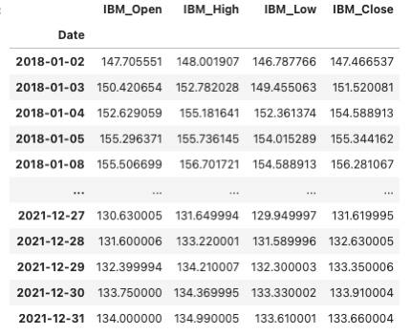
DATA COLLECTION

Slide 6
FEATURE GENERATION
Begin by generating a dataset that contains the predictors which will be used to make the predictions, and the output variable.
Calculated our indicators based on various technical indicators i.e. Rate Of Change(ROC), Momentum (MOM(Moving Average(MA(

Slide 7
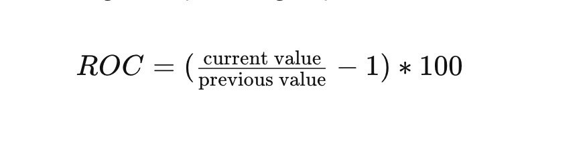
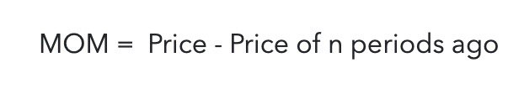
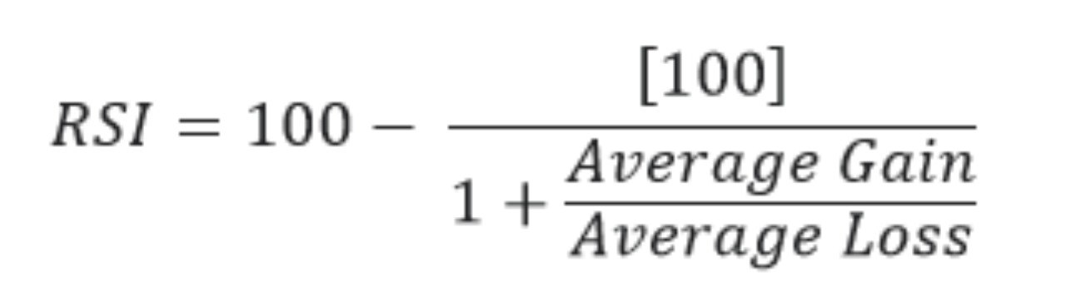
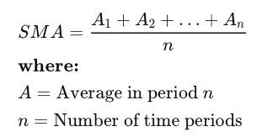
FEATURE GENERATION (TECHNICAL INDICATORS )
Rate Of Change(ROC( : is the speed at which a variable changes over a specific period of time.
Momentum (MOM(: measures the pace of the price fluctuation by comparing current and past values.
The Relative Strength Index (RSI) : is a technical analysis that measures the magnitude of recent price changes to evaluate overbought or oversold conditions in the price of a stock or other asset.
Moving Average(ma(: calculation used to analyze data points by creating a series of averages of different subsets of the full data set.

Slide 8
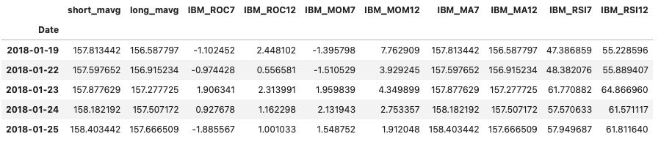
FEATURE GENERATION

Slide 9
DATA VISUALIZATION
The most significant pre-requisite for predictive modeling is to have a good understanding of the dataset.
And also visualize the correlation between the various features, obtained from the model improves its accuracy.

Slide 10
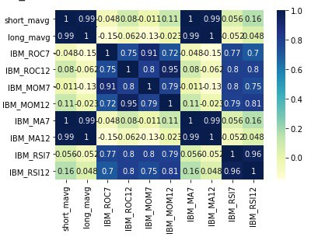
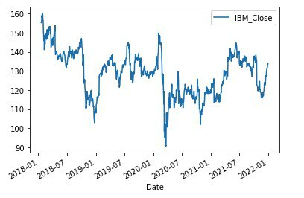
DATA VISUALIZATION

Slide 11
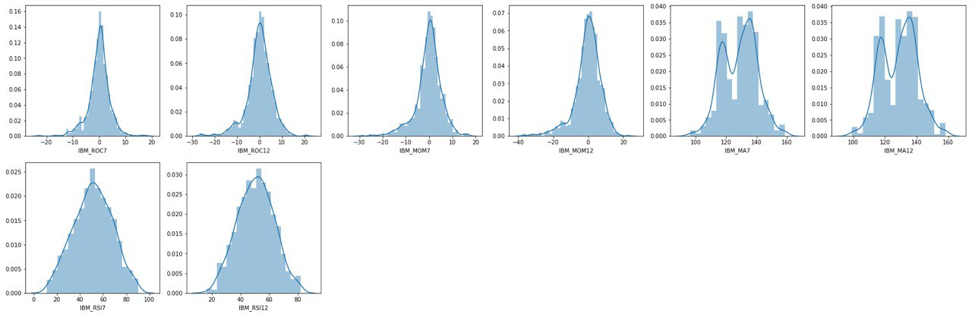
DATA VISUALIZATION

Slide 12
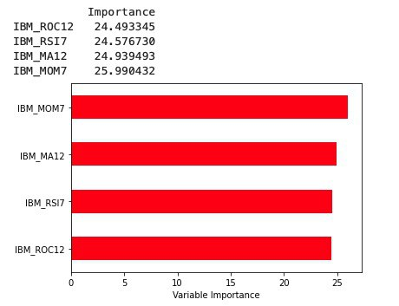
FEATURE SELECTION
Feature selection is the process of selecting a subset of features that are most relevant for model generation which aid in creating an accurate predictive model

Slide 13
SPLITTING
Split the dataset into 70% training set and 30% test
Create 3 models for unseen data and check their accuracy
Evaluate the accuracy of the best model on actual unseen data

Slide 14
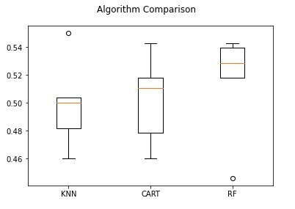
MODELING
Evaluate 3 different methods:
K-Nearest Neighbors (KNN(
Classification and Regression Trees (CART(
Random Forest (RF(

Slide 15
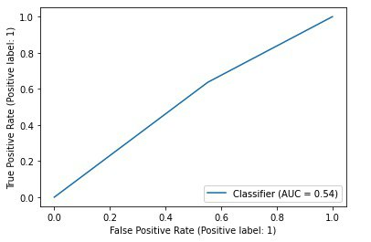
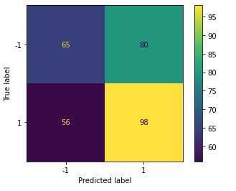
MODELING

Slide 16
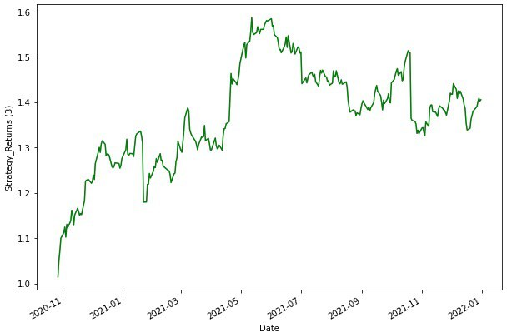
Results On Strategy Return

Slide 17
Conclusion
In conclusion, we used the return strategy on day to day closing price, to help us understand how is our investment strategy going, but since our accuracy is 54% therefore, we made relatively huge losses compared to the returns. Our production did not work as we expected in most cases, it made us sell the stock when we should buy it and buy when we needed to sell and that what cost us the most.

Slide 18
THANK YOU .. ANY QUESTION ?

